Slide 1
State-dependent diversification with fossils: a case study with Canidae
Bruno do Rosario Petrucci, Graham Slater, Michael R. May, Ugnė Stolz, Tracy A. Heath
Ecology and Evolutionary Biology – Iowa State University

Slide 2
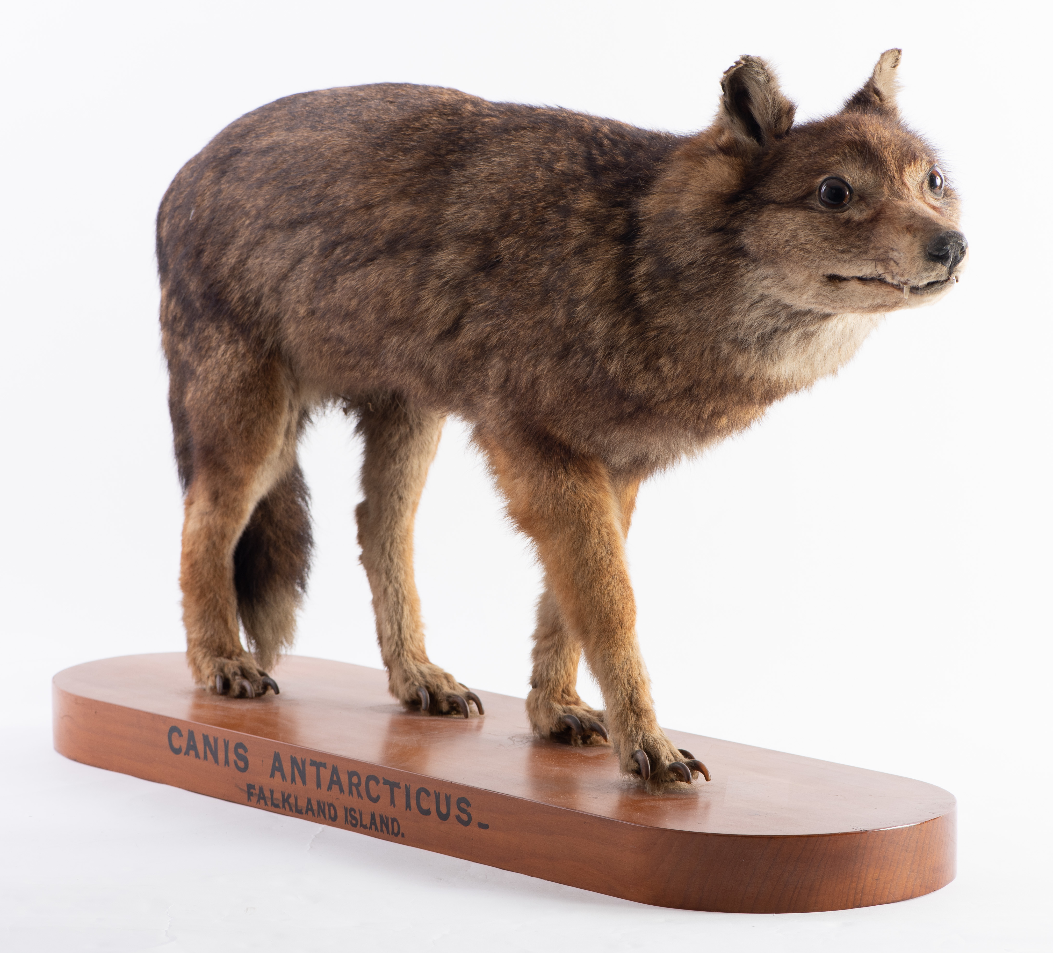
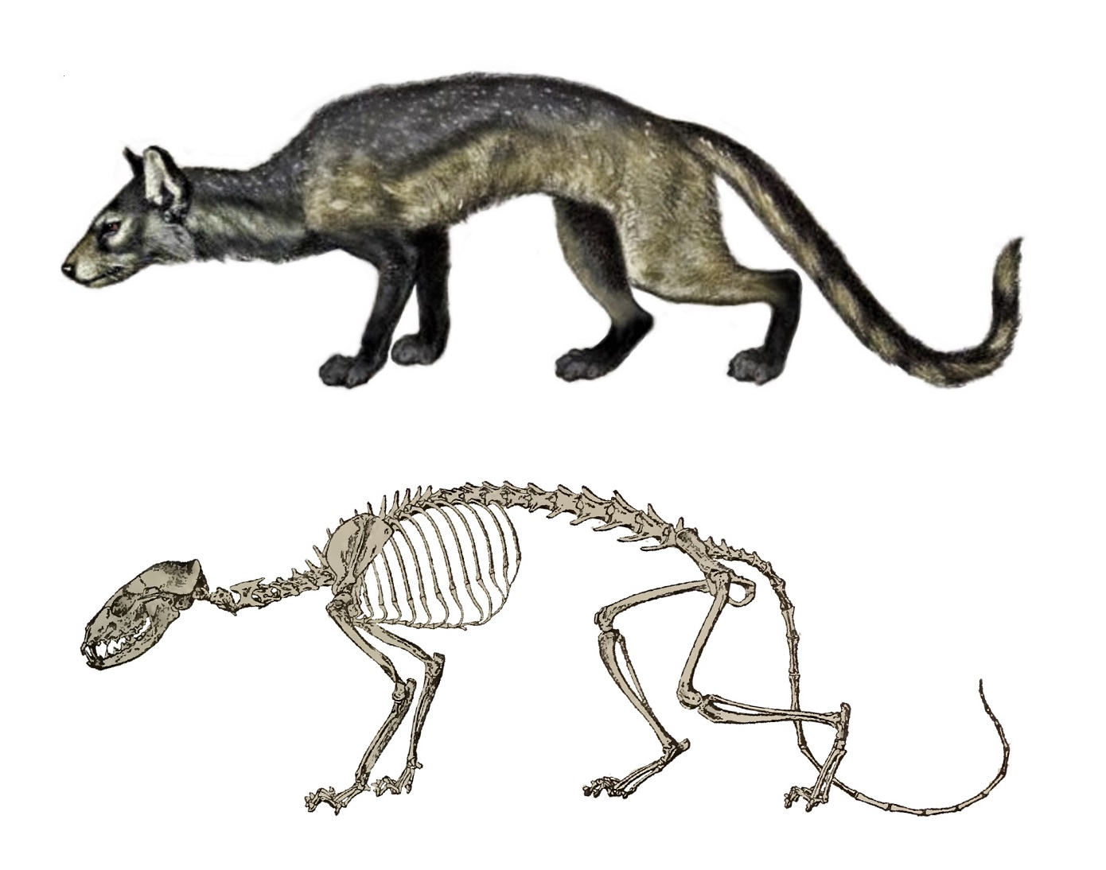
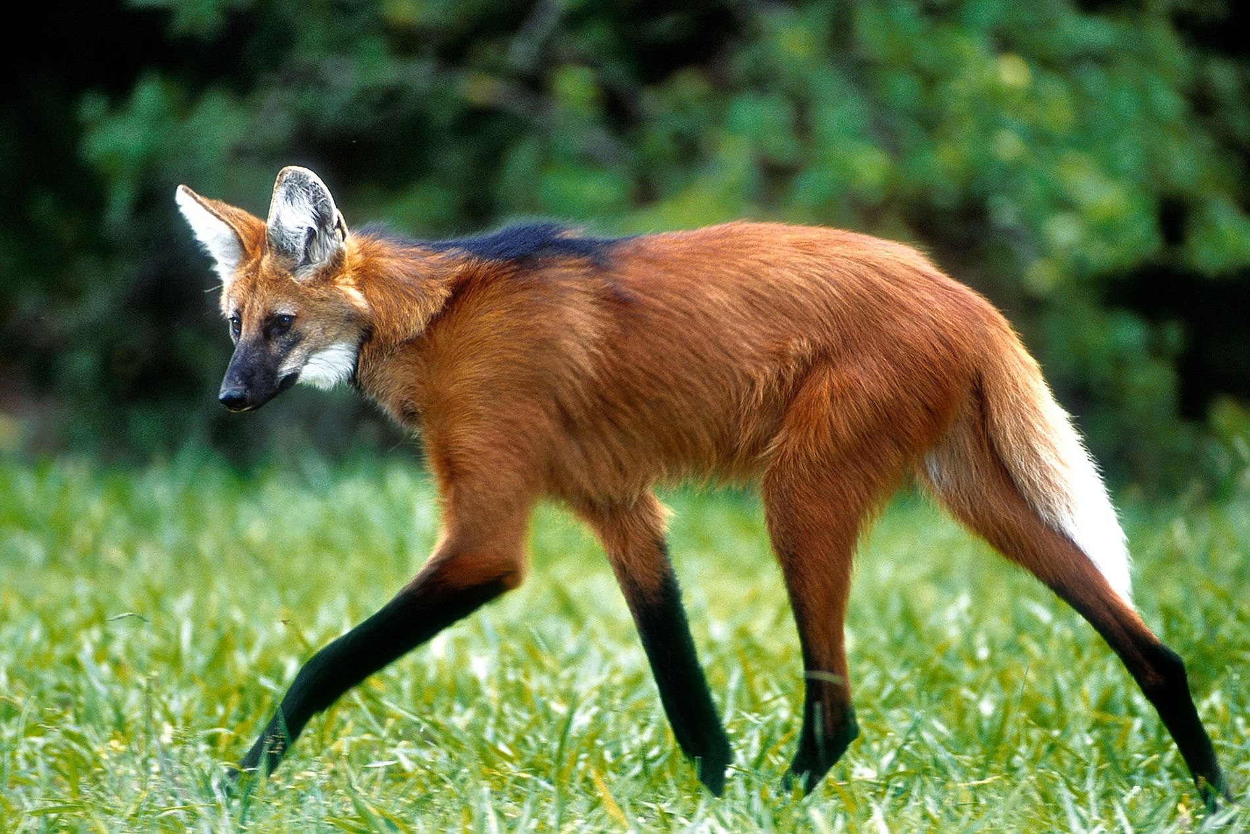
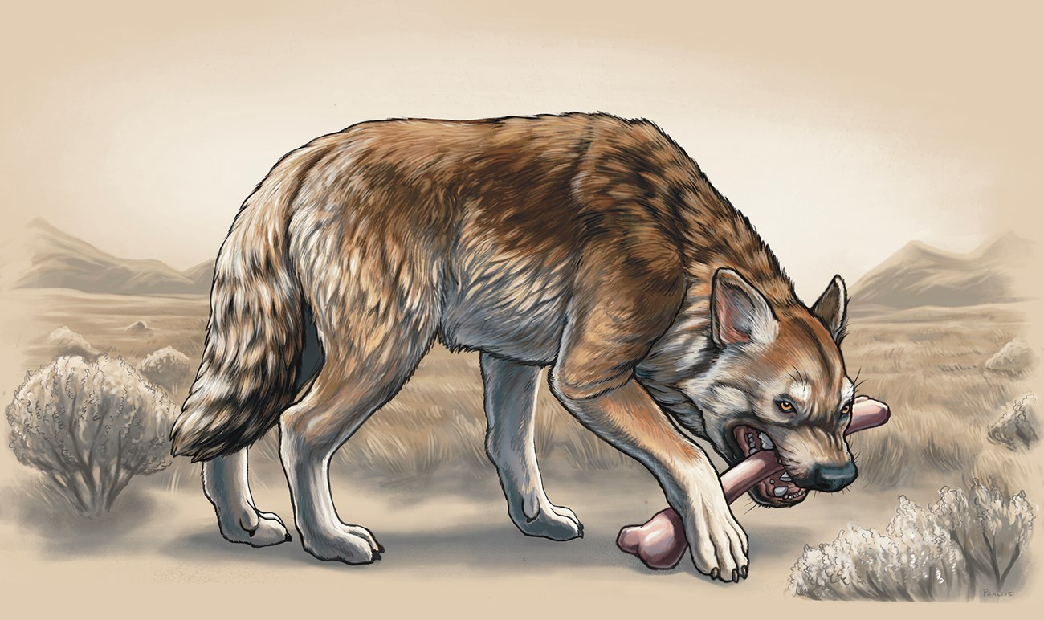
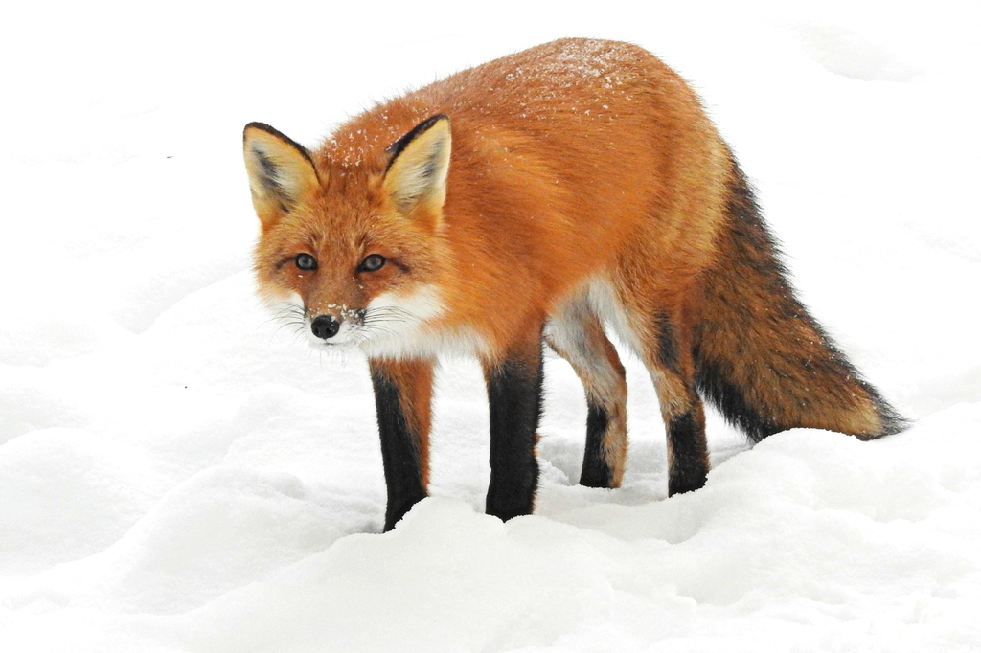
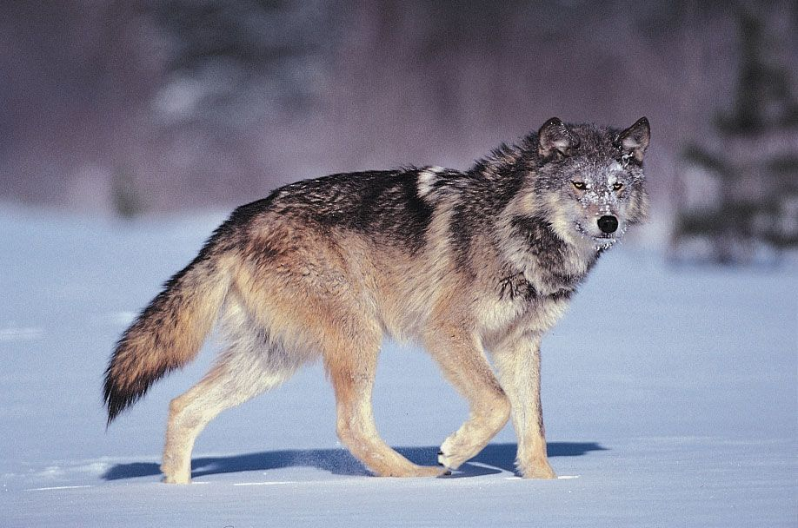
Notes:
- Canids are a great group to use as a model for the study of macroevolutionary and paleontological questions
- Great extant diversity (wolf, fox, guara), well-sampled fossil record (borophagus, hesperocyon), including some recently extinct species with ancient DNA (Falkland islands wolf), and charismatic therefore well-studied

Slide 3
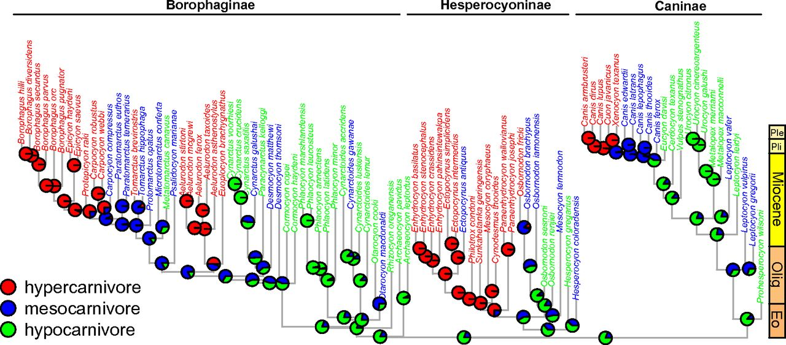
How does diet affect extinction in Canidae?
Canidae has a large diversity of dietary strategies
Is hypercanivory an evolutionary dead-end?
Balisi & Van-Valkenburgh 2020: hypercanivory acts on clade level, but not species level
>70% vertebrates
Slater 2015
50-70% vertebrates
<50% vertebrates
Notes:
- Canidae exhibits a large diversity in dietary strategy, with hyper, meso, and hypocarnivores being well-represented throughout the entire tree
- Extreme specialization such as hypercarnivory is often considered an evolutionary dead-end: increasing fitness in the short-term, but (due to requiring what is thought to be irreversible changes), leading to higher extinction risk
- 2020 paper arrives at the conclusion that that is not the case for large hypercarnivores: extinction rates seem to be similar among hyper and non-hypercarnivores
- In this talk, we will ask this question using model-based methods so as to better estimate the degree of heterogeneity

Slide 4
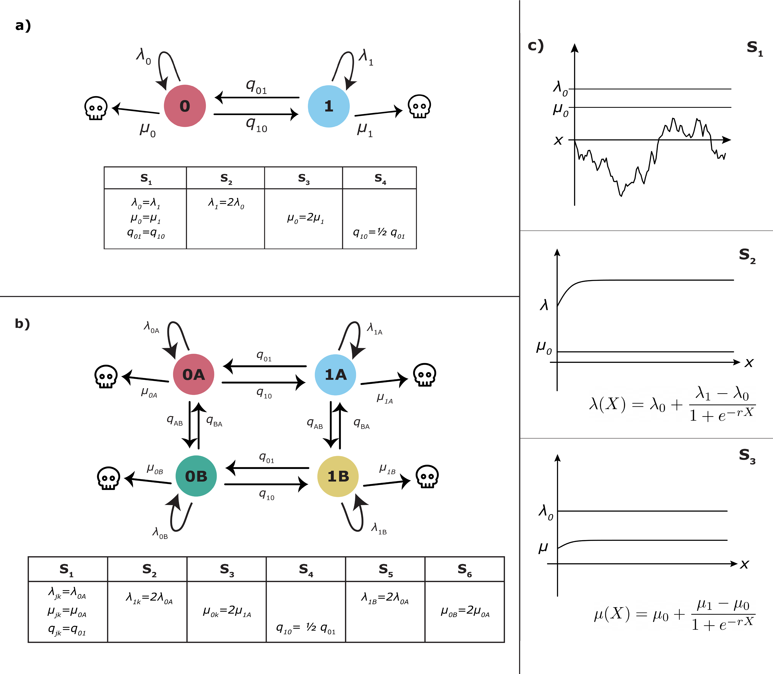
State-dependent diversification models
Hypercarnivorous
Non-hypercarnivorous
BiSSE: Binary trait effects diversification rates
HiSSE: Observed trait + hidden trait affects rates
SSE models have a false-positive problem
Diagrams by Lucy Hiegata
Maddison et al 2007; Beaulieu & O’Meara 2016
Notes:
- State-dependent speciation and extinction (SSE) models are widely-used extensions of birth-death models used to investigate trait effects on diversification rates
- BiSSE: binary trait controlling rates. Species take trait values 0 and 1, transitioning between them as time passes, and take on speciation and extinction values corresponding to each state
- HiSSE: like BiSSE, but we allow for the possibility of an unobserved (hidden) trait affecting rates as well
- SSE models tend to assign diversification-rate effects to neutral trait, a sort of false-positive issue. HiSSE is a bit less vulnerable, but in the future I need to apply a more involved workflow to investigate

Slide 5
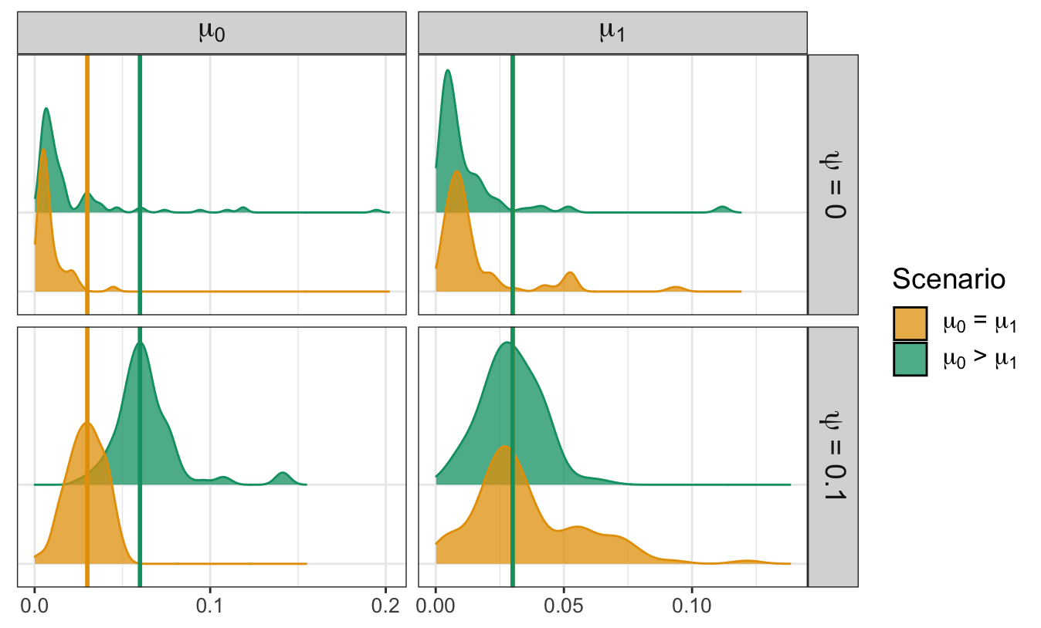
Fossil data are necessary
Without fossils, extinction-rate estimates are inaccurate
Increasing fossil sampling leads to increasing precision and accuracy
do Rosario Petrucci et al, under review
Notes:
- In a paper I submitted a month ago, we show with simulations that fossil data increases extinction-rate estimate accuracy, while preserving speciation estimate accuracy
- Here (posterior mean for extinction for states 0 and 1 across 100 simulations) we see that only when we have fossils (psi = 0.1) do we see the model correctly detecting heterogeneity in extinction rates (green plot vs. yellow)

Slide 6
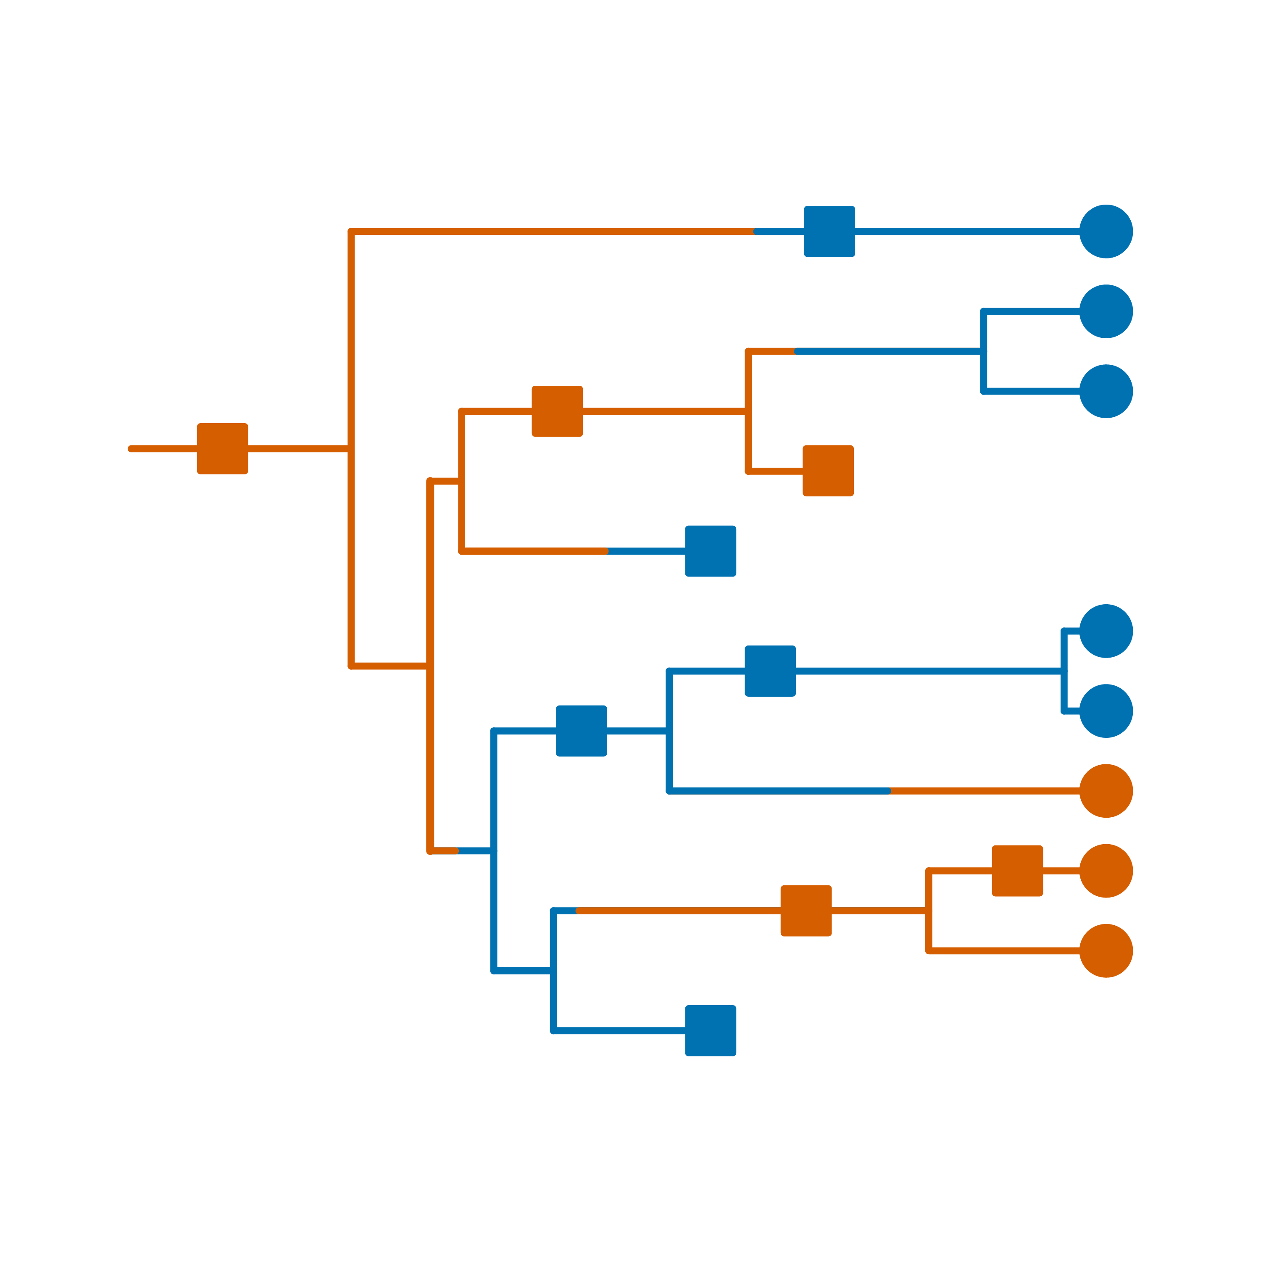
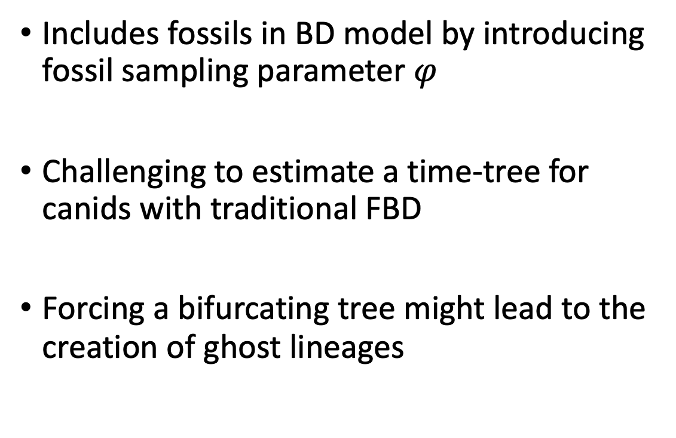
Fossilized-birth death (FBD)
0012003021?
Includes fossils in BD model by introducing fossil sampling parameter $φ$
Challenging to estimate a time-tree for canids with traditional FBD
Forcing a bifurcating tree might lead to the creation of ghost lineages
Diagram by Lucy Hiegata
Stadler 2010; Heath et al 2014
Notes:
- Integration of fossils with BD models such as SSE is usually done using the fossilized birth-death (FBD) model, where fossils are sampled following a poisson process with some rate psi
- First we need to estimate the tree, however, and it is challenging to do so with FBD because it is taxonomy-independent, and taxonomy really guides the structure and representation of the canid fossil record. Lots of fragmentary fossils, so the morphological matrix is sparse for the individual fossils
- Also, forcing a bifurcating tree might not be ideal, since there are a lot of cases of sister species where one is much older, and budding is probably what happened, so we’re creating ghost lineages and biasing divergence times (and therefore diversification rates) by forcing bifurcation

Slide 7

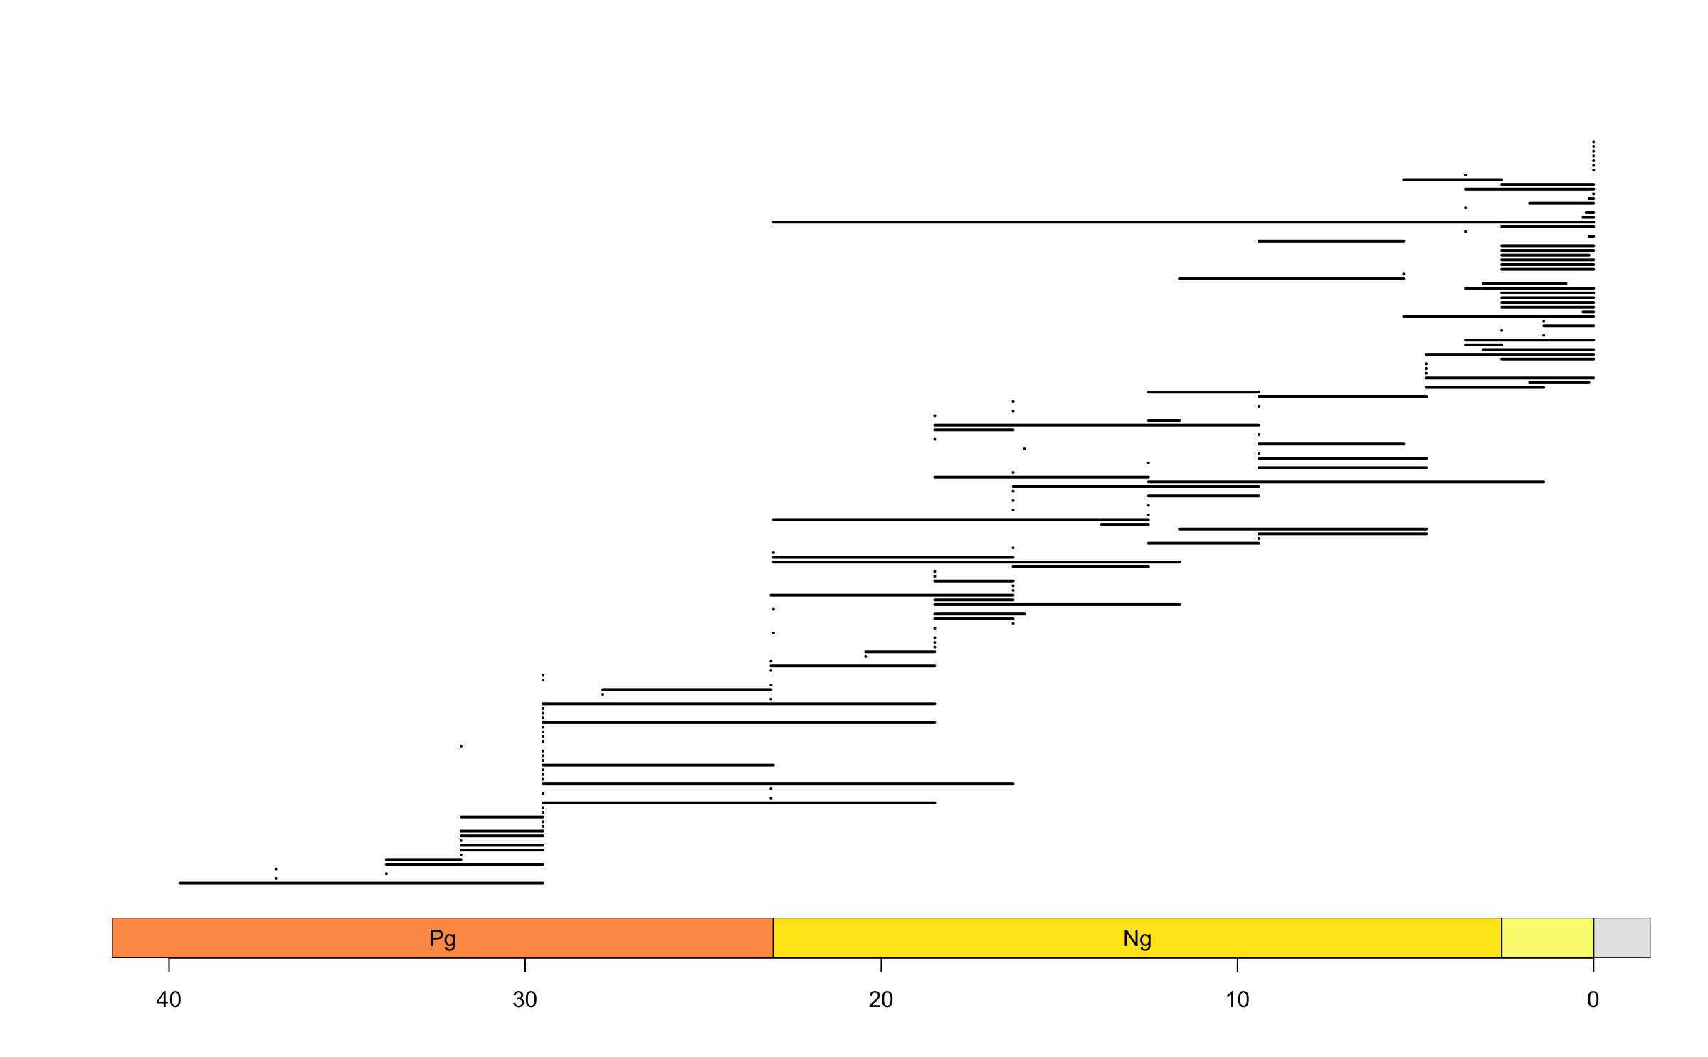
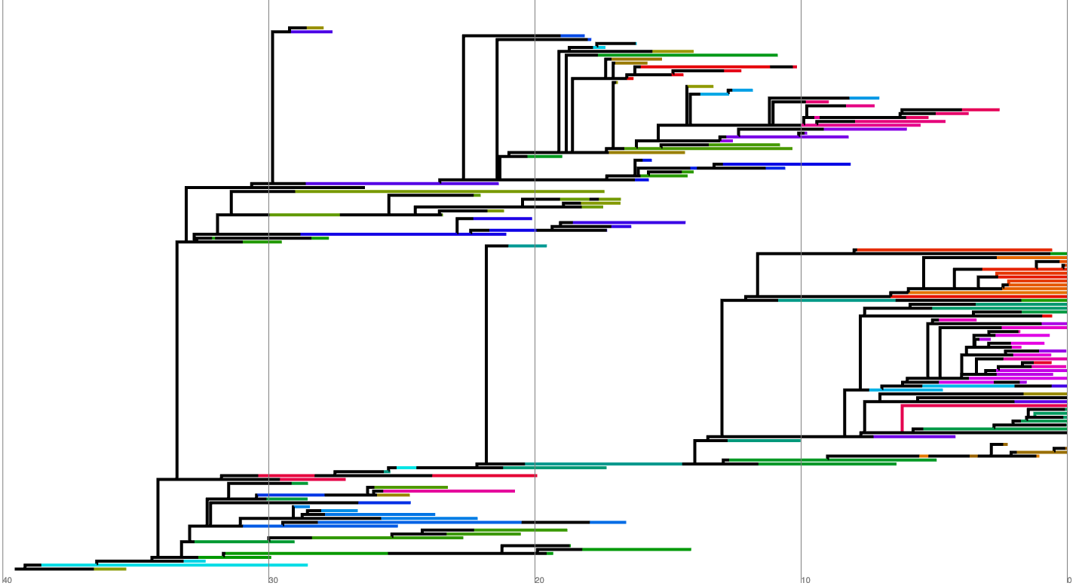
Stratigraphic range FBD (SRFBD)
Taxa have stratigraphic ranges, not just one occurrence time per fossil
Molecular and morphological data attached to each range
Tree obtained with BEAST2 (sRanges package)
0012003021
Stadler et al 2018; Stolz & Gavryushkina et al, in prep; Bouckaert et al 2014
Notes:
- SRFBD is a model that allows for data organized into stratigraphic ranges, not fossil occurrences, which is more in line with how actual paleontological data is organized
- It also allows us to set molecular and morphological data for a species, rather than to each occurrence, getting rid of the monophyly problem
- We ran an SRFBD model using the sRanges package on Beast2, and ended up with this tree. 158 species including 34/36 extant species

Slide 8
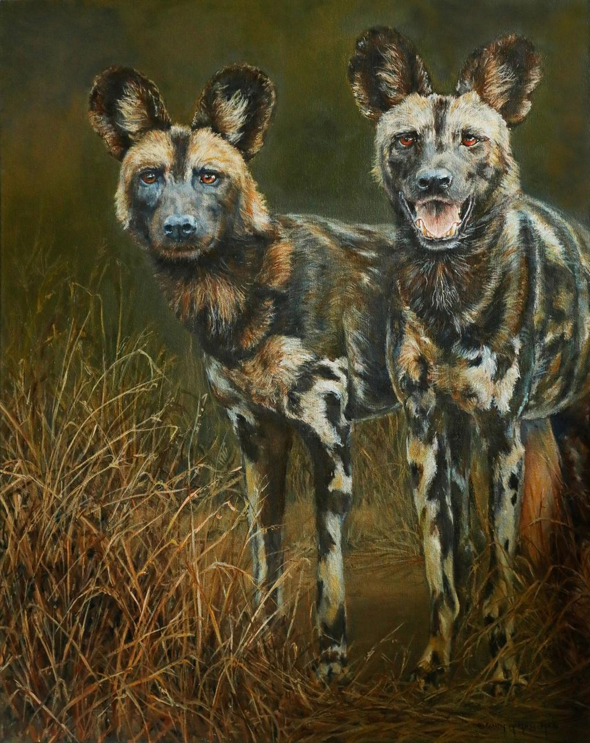
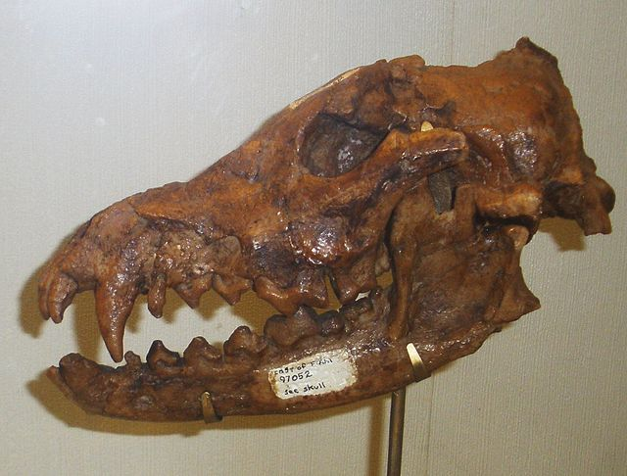
Budding tree can provide novel insights
Xenocyon sp.: larger body hypercarnivore
Lycaon pictus: smaller body hypercarnivore
Notes:
- Xenocyon is a genus of large bodied, large headed hypercarnivores that are ancestors to African wild dogs (smaller bodied, still large headed hypercarnivores)
- Implies some sort of directionality where large body is required to develop hypercanivory, and then can be streamlined for a more agile body

Slide 9
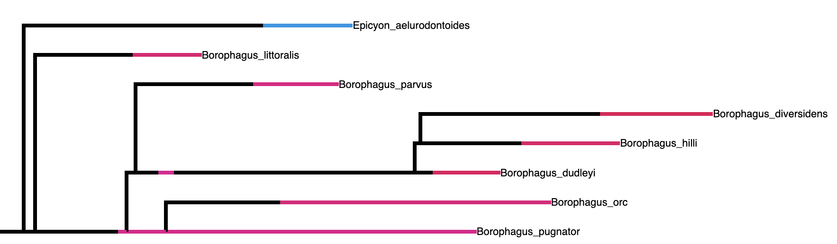
Budding tree can provide novel insights
Epicyon: larger body hypercarnivore
Borophagus: smaller body hypercarnivore
Notes:
- Budding tree provides another example of this narrative, where Epicyon represents the larger bodied hypercarnivore, and Borophagus the smaller bodied one, here at a subset of our bigger tree
- In previous (bifurcating) trees, they are usually sister clades, which wouldn’t always allow for a statement about the directionality of the effect
- We still need to investigate this further (and with a better tree), but it is a great example of how a budding tree can help our understanding of macroevolutionary patterns

Slide 10

Notes:
- Remember our guiding question: how does diet affect diversification?
- Now that we have a tree, we can apply SSE models to it as we had discussed

Slide 11
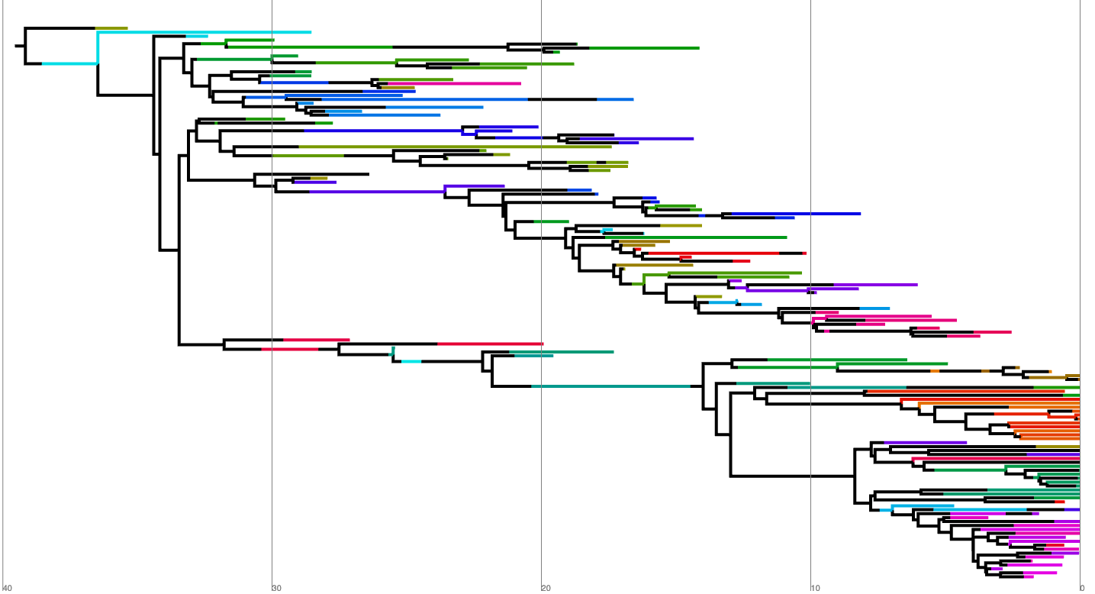
Notes:
- Unfortunately though, there is no way currently to integrate SRFBD and SSE models, so we’ll need to make the tree bifurcating (and break up the ranges into the individual fossil samples)

Slide 12

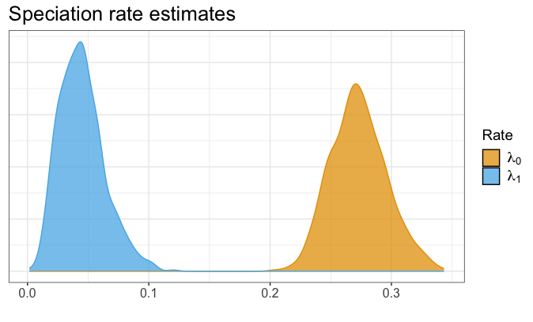
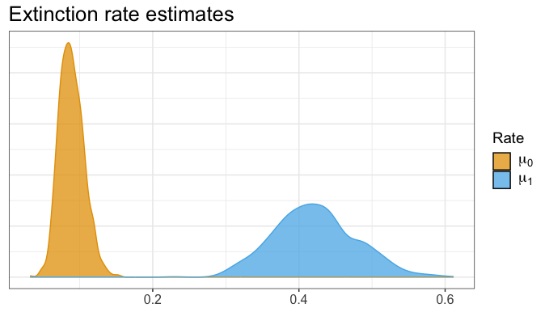

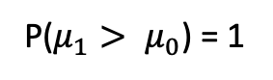
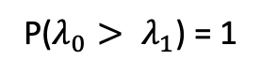
BiSSE: Higher $λ$ and lower $μ$ for hypercarnivores
P($λ_{0}> λ_{1}$) = 1
P($μ_{1}> μ_{0}$) = 1
Höhna et al 2016
Notes:
- Analyses ran on RevBayes with the TensorPhylo plugin, combining SSE and FBD specimen models (had to convert tree into bifurcating to use SSE, in the future would be good to combined FBDR and SSE)
- When looking at the BiSSE results, it seems like the narrative about hypercarnivory is only half correct: speciation rates are pretty elevated, but extinction rates actually seem much reduced. This goes against the consensus, but does support the 2020 paper
- One might wonder whether the false-positive problems common to SSE models are present here, however, so a HiSSE analysis is in order

Slide 13
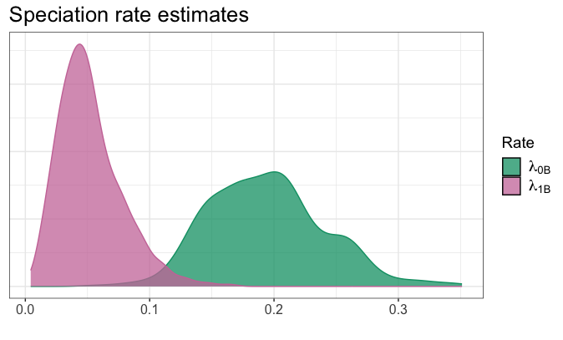
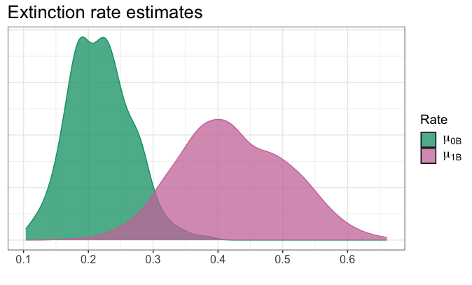
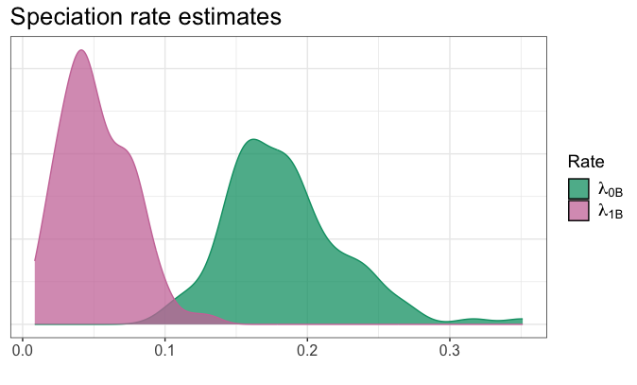
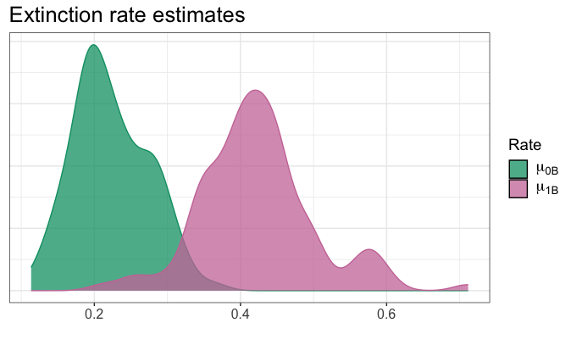
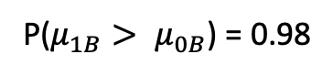
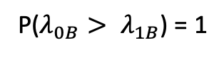
HiSSE: Hidden states have a strong effect
Hypercarnivores
P($λ_{0B}> λ_{1B}$) = 1
P($μ_{1B}> μ_{0B}$) = 0.98
Notes:
- When looking at the estimates for 0B and 1B, the pattern is pretty much the same, with state 0 having higher lambda and lower mu, though with much mover overlap between the posteriors

Slide 14
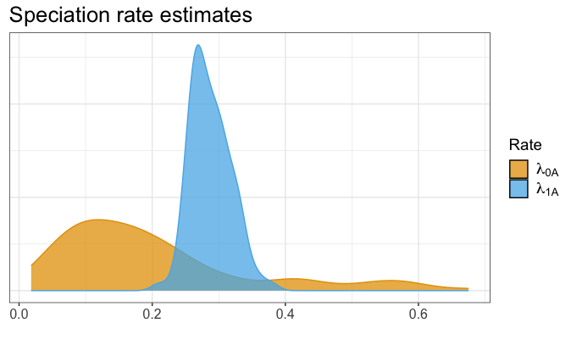
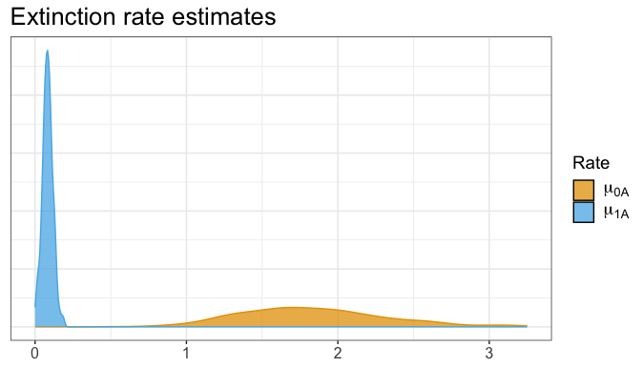
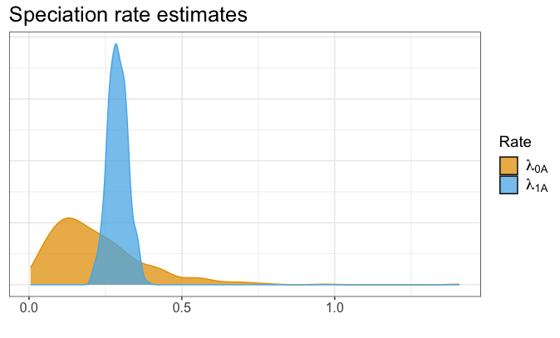
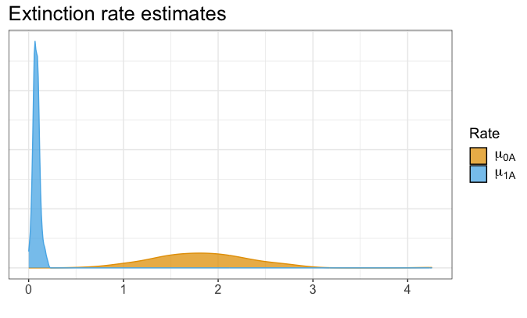
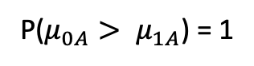
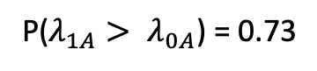
HiSSE: Hidden states have a strong effect
Hypercarnivores
P($λ_{1A}> λ_{0A}$) = 0.73
P($μ_{0A}> μ_{1A}$) = 1
Notes:
- When looking at hidden state A though, things get more complicated. Seems like this hidden trait does have a large effect, where it is acting in conjunction to hypercarnivory to lead to lower speciation (though the posterior seems pretty wide) and higher extinction

Slide 15
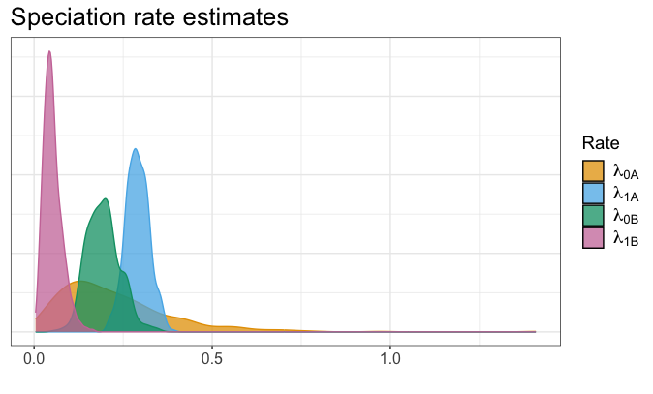
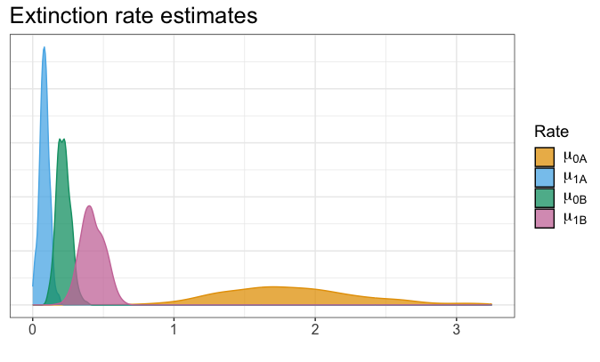
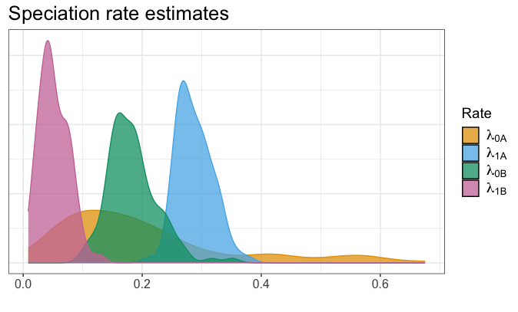
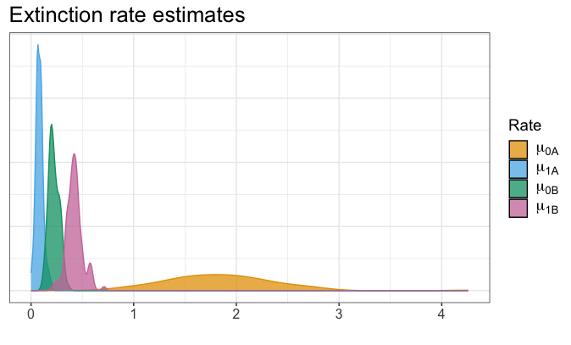
HiSSE: Hidden states have a strong effect
Hypercarnivores: state 0
Notes:
- Looking at all the posteriors at the same time shows that results are still pretty uncertain: there’s a lot of overlap, especially for speciation rates
- Still, one thing the model seems to be certain on is that there is some trait working in conjunction with hypercarnivory to raise extinction rates
- This might explain the lower species durations that Balisi 2020 saw, considering that they didn’t find higher extinction for hypercarnivores themselves

Slide 16
Conclusions
Budding trees can be useful for macroevolutionary insights on paleontological datasets
There is signal on the data pointing to an effect of hypercarnivory on diversification rates, but…
…it seems like there is a second trait working in concert with diet to generate higher extinction rates
Notes:
- FBDR is an amazing innovation, and can help us to work with datasets that are not suited for FBD. Here we exemplified how budding trees can be good tools for studying macroevolutionary questions with paleontological datasets
- We saw that hypercarnivory does seem to have an effect on diversification rates, but that effect is more nuanced than it seems when first looking at a BiSSE graph
- HiSSE showed that there seems to be a second trait working in concert with hypercarnivory to drive the extinction up, and this is another example of why we need to dig deep when trying to answer these questions, instead of just trusting the first result we find

Slide 17
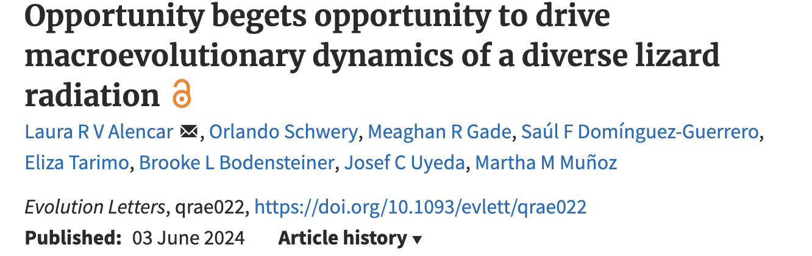
Future work
Include more traits in analysis
Develop a more involved workflow to further investigate the effects of separate traits and the possibility of false-positives
Obtain an SRFBD tree with both bifurcation and budding speciation
Integrate SRFBD with SSE models
Notes:
- Including more traits will be important to investigate these patterns, and hopefully find which trait is working together with diet
- A more involved workflow can be useful to parse out the effects of different traits and their interactions, and to disentangle the false-positives. A great example is Laura Alencar’s talk earlier today, which used a pipeline of multiple steps and different SSE models
- It would be good to implement bifurcating speciation in the model, so we can more clearly see when each type of speciation is more adequate and really dive deep on those macroevolutionary questions
- Integrating FBDR with SSE models would be ideal to have a more integrated workflow, instead of mixing models as we’re doing now

Slide 18

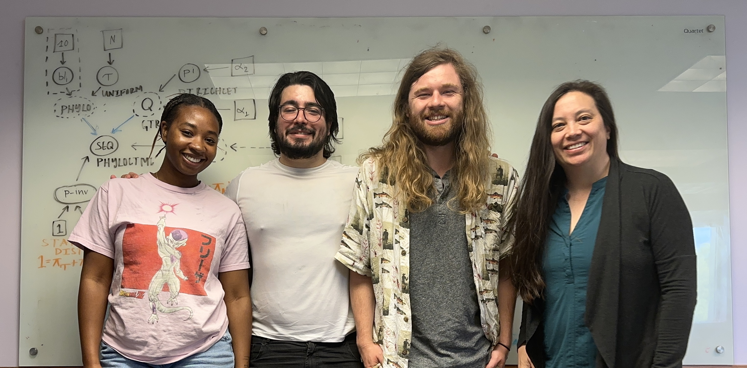


Thank you!
The Heath lab at ISU
Co-authors:
Graham Slater (University of Chicago)
Michael May (UC Berkeley & Davis)
Ugnė Stolz (ETH Zurich, Swiss Intitute of Bioinformatics)
Tracy Heath (Iowa State University)
PhD committee:
Dean Adams
Haldre Rogers
Jeanne Serb
Graham Slater
Other collaborators:
Joëlle Barido-Sottani
Tiago Quental
Matheus Januário
Elizabeth Glynne Boenigk
Orlando Schwery
Funding:
EEB

Slide 19
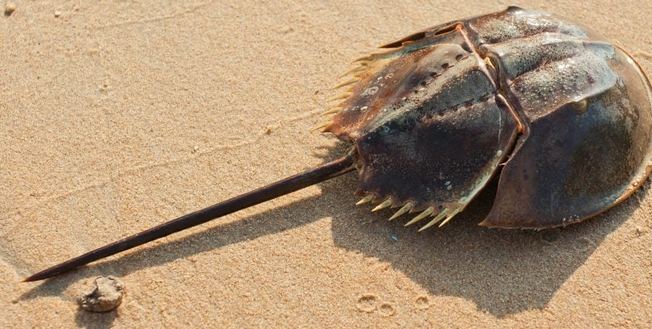



Questions?
petrucci@iastate.edu
brpetrucci

